Slide 2

MODULE -3 ENTREPRENEUR
By,
Prof. Muneshwara M S
Dept. of CSE, BMSIT&M, Yelahanka,
Bengaluru-560064

Slide 3

 Meaning of Entrepreneur
 Characteristics of Entrepreneur
 Classification & Types of Entrepreneur
 Stages In Entrepreneurial Process
 Role of Entrepreneurs in Economic Development

Slide 4
Entrepreneur –an Emerging Class.
 Entrepreneurship in India
 Entrepreneurship – its Barriers.
 Identification of Business Opportunities
 Market Feasibility Study
 Technical Feasibility Study
 Financial Feasibility Study
 Social Feasibility Study.

Slide 5

 Entrepreneur is a person who undertakes an enterprise. The process of creation is called entrepreneurship.
 An entrepreneur can be considered as a person who bears the risk of operating a business in the face of uncertainty about the future conditions.
 Entrepreneur as One Who Always searches for Change, Responds to it & Exploits it as an Opportunity.

Slide 6
 Entrepreneur is one
Who innovates and introduces something new in the economy.
Who shifts resources out of an area of lower and
into an area of productivity and greater yield.
Who plays a critical role in economic development and an integral part of economic transformation.
 Entrepreneur is an agent who buys the four factors of production at certain prices in order to combine them into product with a view to selling it at uncertain prices in future.

Slide 7

 You are your own boss, boss to other
 Chance to put your ideas into practice
 Make money for yourself
 Chance to work directly with your customer
 Personal satisfaction of creating & running business
 Work in a field of your interest
 Get experienced in various discipline

Slide 8

1. Creativity
Germination, Preparation, Incubation,
Illumination, Verification
Innovation
Dynamism
Leadership
Teambuilding
Achievement motivation
Problem solving
Goal Orientation
Risk taking & Decision making ability
Commitment

Slide 9

 He is a Person who creates Enterprise. The Process
Creation is called as ―Entrepreneurship‖.
 This evolved from the French Word ―Entreprende‖ in the 12th Century.
 In the early 16th Century, it was applied to those
who were engaged in Military Expeditions.
 In the 17th Century, it was extended to cover Civil Engg Services.
 In the 18th Century, Richard Centillon described Entrepreneur as “One Who Bears Risk by buying at Certain Prices & selling at Uncertain Prices” which is closer to the Terms as Applied Today.

Slide 10
1. Planning of the project:
idea of launching structure of the
the project and Program
business
Management: responsible for the management of business
To Face Risks: faces uncertainly & bears risks
Distribution of Rewards: pays the reward in the shape of rent, wage, & interest and bears the risk of profit or loss himself

Slide 11
Sale of Products: responsible of marketing,
advertising
Scale of Production: decided the scale of business, takes the decision of what where and how to produce goods.
Joint stock Organization: In a partnership, the entrepreneurial functions are divided between the
partners. But in entrepreneurial
public decisions
limited company the are left to the
government or a body to which government has delegated its powers.

Slide 12
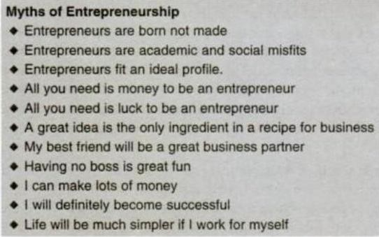

Slide 13

I) Classification of Entrepreneurs based on Functional Characteristics
Innovative Entrepreneur: Introduces New Goods / Products / Services or New Methods of Production or discovers New Markets or Reorganizes his Enterprise.
Imitative or Adoptive Entrepreneur: Imitate or Copy Techniques & Technology
Fabian Entrepreneur: display great caution & skepticism in experimenting with any change in their Enterprise.
Drone Entrepreneur: Die – Hard Conservative Attitude, do not easily seize opportunities to make changes in their production techniques or the Technology employed

Slide 14










Classification of Entrepreneurs on the
Development Angle :
Prime Mover: sets into Motion a Powerful Sequence of Development, Expansion & Diversification of Business
Manager: does not initiate Expansion & is content just Staying in Business
Minor Innovator: contributes to Economic Progress by finding better use for Existing Resources
Satellite: assumes a Supplier’s Role & slowly moves towards a Productive Enterprise
Local Trading: limits his enterprise to the Local Market.

Slide 15




III) Classification of Entrepreneurs based on Types of Business :
Manufacturing: Entrepreneur is involved in Production of Value Added Goods by using Various Inputs
Wholesaling: An Entrepreneur with such a Business sells Products to the Middle Men or Retailers
Retailing: An Entrepreneur with such a Business sells Products directly to the Consumer’s or End Users.
Service: An Entrepreneur in this Business sells Services & not the Products.

Slide 16
IV) Classification of Entrepreneurs as per the
Behavioral Scientists :
Solo Operators: work alone, introduce their own capital
Active Partners: jointly put their efforts and resources
Inventors:interest lies in research and innovative activities
Challengers : entrepreneurs plunge into industry
/business because of the challenge it presents.
Buyers : Purchase the existing one and by using their experience and expertise try to run the enterprise successfully.
Life Timers: integral point of their life
Industrial entrepreneurs: Such entrepreneurs engage in manufacturing and selling products.

Slide 17
According to growth
growth
super growth
According to stages of development
modern
classical
According to the area
urban
rural
According to the gender and age
men
women
According to the sale of operation
small
large

Slide 18

 Economic independence
 Establishing their own creativity
 Establishing their own identity
 Achievement of excellence
 Building confidence
 Developing risk taking ability
 Motivation
 Equal status in society
 Greater freedom and mobility

Slide 19
Exploration of the prospects of starting a new business
Pool up the resources
Establish the industrial enterprise
Manage the business
Development of strategies.
To assume risk & uncertainty
To develop business & business decision
Motivation
Supervision & leadership

Slide 20

Lack confidence
Problem of finance & working capital
Socio- cultural barriers
Production problem
Inefficient Marketing Arrangements
Male dominations

Slide 21

Provide basic education & establish special institutions to train women entrepreneurs.
Conduct special workshops to women for better awareness.
Liberal financial support to motivate women entrepreneurs
Favourable credit policies to women
Provide better marketing help to women entrepreneurs

Slide 22
Provide need- based training for development of skills & entrepreneurship.
Establish self-help groups, Voluntary agencies & social welfare organization for women entrepreneurs
Provide concessions to women entrepreneurs.
Provide a common platform to all the concerned agencies & R & D organization to achieve an interacted approach for promoting women entrepreneurs.

Slide 23

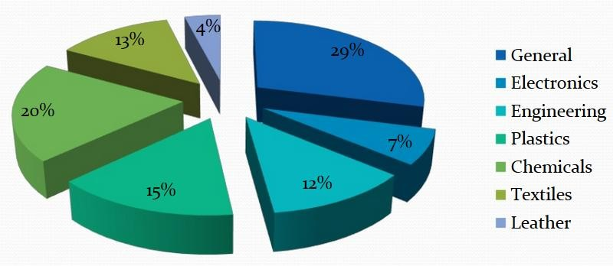

Slide 24
 Suchi Mukherjee
CEO of the online social discovery platform for women, LimeRoad http://techstory.in/suchimukherjee/
 Anu Sridharan
Founder of NextDrop, a company which allows Indian residents in the urban areas to track the availability of piped water through SMS.

Slide 25

A manager within a company who promotes innovative product development and marketing.
 Is an emerging class found in large industrial organizations who emerge from within the confines of the large industrial organizations.
 Top executives are encouraged to catch hold of new ideas and convert them into products through research and development activities within the framework of the organization.
 Dependent, does not bear risk in business, does not raise funds, operates from inside.

Slide 26
An intrapreneur is an individual who works on developing new ideas and products within the confines of the business that they already work at
Intrapreneurs include any person within the company that applies entrepreneurial skills, vision, and forward thinking into the role that they have in the company
One of the more appealing reasons to be an intrapreneur is that it allows you to form new ideas, products, and business goals without taking on the risks that come with starting a new business as an entrepreneur.

Slide 27
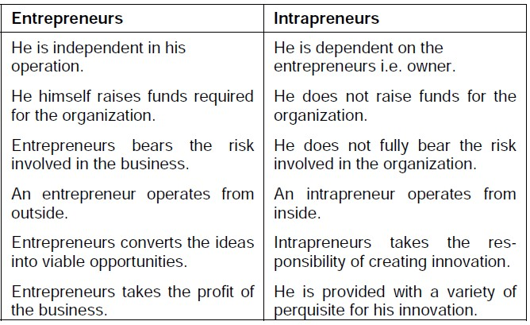

Slide 28

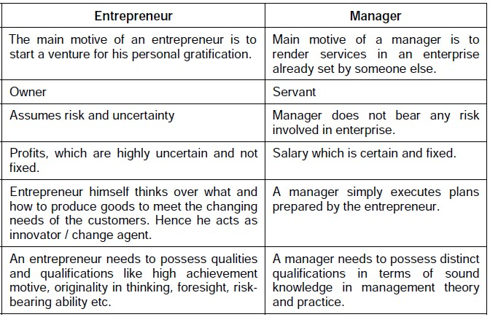

Slide 29

1) Perceiving ,identifying opportunity
Evaluating opportunity
Description of product
Agreement of opportunity
Assessment of the entrepreneur
Resources needed
Amount & sources of capital
Profit expected

Slide 30
3) Drawing up a business plan
Title of project, table of contents
Description of business & industry.
Technology plan
Financial plan
Organization plan
Production & operation plan
Marketing & distribution plan
Summary
Marshalling resources
Creating the enterprise
Consolidation and management

Slide 31

1) Promotes capital formation by mobilizing the idle saving of the public.
2) Provides employment
immediate thereby
large reducing
scale
the
unemployment problem in the country.
Promotes balanced regional development.
Helps reduce the concentration of the economic power.

Slide 32
Stimulates equitable redistribution of wealth, income and even political power in the interests of the country.
Encourages effective resource mobilization of capital and skill which otherwise would remain unutilized and idle.
Induces backward and forward linkages which stimulate the process of economic development in the country.
Promotes export trade which is an important ingredient for economic development

Slide 33
Lack of a viable concept
Lack of market knowledge
Lack of technical skills
Lack of seed capital
Lack of business know how
Complacency—lack of motivation
Social stigma
Time presence and distractions
Legal constraints and regulations
Monopoly and protectionism
Inhibitions due to patents

Slide 34

 It focuses on indentifying entrepreneurship qualifies of an individual, providing required
training, preparing related project reports,
manage
preparing the entrepreneurs to
finance, Production, technology marketing & infrastructure facilities.
 EDP also provides knowledge to solve problems &difficulties of entrepreneur.

Slide 35

 Builds confidence in people
 Gives guidelines to the young
 Gives technical assistance, management, training consultancy.
 Channelizes them to accelerate industrialization
 It is helpful in growth of small scale section.

Slide 36

Entrepreneurship is regarded as closely associated with the Economic History of India.
This is traced way back to even as early as Rig Veda, when Metal Handicrafts manufacturing cottage & small enterprises existed in the Country.
It has passed thro several Ups & Downs.
The important ones include the Decline of Indian Handicrafts Industry towards the end of the 18th Century, entry of the East India Company of the British’s in India’s Business Activities.

Slide 37
The Swadeshi Campaign for Indian Manufactured Goods, the First World War, Emergence of the Indian Managing Agency Systems by promoting Joint Stock Companies, the Second World War, Partition of Undivided India & undertaking planned development of Entrepreneurship in the Country by Govt of India after Independence in 1947.
For the purpose of encouraging Entrepreneurship, the Govt of India brought out the First Industrial Policy Resolutions in 1948 which was subsequently revised from Time to Time.

Slide 38
The Govt of India in order to promote , assist & develop industries in the National Interest has taken the following Three Important Resolutions in the Industrial Resolutions :
To maintain a proper distribution of economic power between Private & Public Sector.
To encourage Rapid Industrialization by moving the concept of Entrepreneurship from existing centers to other cities, towns & rural areas.
To disseminate the Entrepreneurship acumen concentrated in a few dominant communities to a large number of Industrially Potential People of varied Social Background.

Slide 39
 To achieve these Objectives the Govt accorded emphasis on the Development of Small Scale Industries in the Country.
 Since the 3rd Five Year Plan, the Govt announced various Incentives & Concessions in the form of
Capital, Technical Know How,
Reservation of Certain Items for Exclusive Manufacture in Small Scale Sector Tax Concessions,
Provision of Infrastructural Facilities like Developed Land, Sheds, Roads, Communication etc for Promotion of Enterprises in the Country etc.
 This has helped in Speedy Economic Development in all the States in the Country & to a great extent has minimized regional imbalances.

Slide 40
 National Common Minimum Programme (NCMP)
Describes Small Scale Enterprises as the Most
Employment Intensive Segment. At the beginning of the 10th Plan, (2002 – 2003), the Segment provided gainful employment to 24.9 Million People in the Rural & Urban Areas of the Country thro 10.5 Million Units, engaged in Manufacturing & providing a Wide Range of Goods & Services. If the Units in Khadi Village Industries are also taken into account, the Employment would rise to 332 Million.
 Thus this is rightly called as the segment which provides employment next only to Agriculture. The Contribution of Small Enterprises Segment to the Economic Development of the Country is very significant. Nearly 39% of the Gross Manufacturing Output & 34% of the Exports of India arise from these Enterprises.

Slide 41
 Yet a large number of Entrepreneurs are facing lots
of Challenges. In order to assist them harness their potential by availing
to fully of the
increasing opportunities generated by Trade Liberalization, it is necessary to not only build an enabling Policy Environment but also supplement the former with a specific set of measures to address the continuing challenges.
 | Therefore Ministry | of | Micro, Small & Medium
 | Enterprises, Govt | of | India has announced a
 | package for Promoting |  | such enterprises in Feb 07
to provide full | support in the | Areas of Credit,
Technological | Up gradation, | Marketing &
Infrastructural | Up gradation in | Major Industrial
Infrastructure etc.

Slide 42
 The opportunity to be your own boss, to implement your own ideas, to earn for himself or herself is reason to think of starting an SSI unit.
 Entrepreneur who starts their own business can be grouped into two broad categories.
People who know exactly what they want to do and are merely looking for the opportunity or resources to do it.
People who want to start their own business, but do not have definite ideas about what may would like to do.
42

Slide 43
 Project identification is concerned with the collection complication and analysis of data for the eventual purpose of locating possible opportunities for investment and with the development of the characteristics of such opportunities.
 Opportunities, according to Drucker, are of three kinds:
1. Additive
2. Complimentary
3. Break-through.
43

Slide 44
Additive opportunities are those opportunities which enable the decision maker to better utilize the existing resources without in any way involving a change in the character of business.
Additive opportunities involve the least amount of disturbance to the existing state of affairs and hence the least amount of risk.
2. Complementary opportunities involve the introduction of new ideas and as such do lead to certain amount of change in the existing structure.
3. Break-through opportunities on the other hand, involve fundamental changes in both the structure and character of business.
44

Slide 45
 The output characteristics of a project define what the project will generate in the form of goods and services, employment revenue etc.
 The quantity and quality of all these output should be clearly specified.
 In addition every project will have impact on society. It inevitably affects the current equilibriums of demand and supply in the economy.
 It is necessary to evaluate carefully the sacrifice which the society will be required to make and the benefits will not accrue to the society from a given project.
45

Slide 46
 Project identification cannot be complete without
identifying the characteristics of the project.
 Every project has three elements—inputs, outputs and social costs and benefits.
 The input characteristics define what the project will consume in terms of raw material, energy, manpower, finance and organizational setup.
 The native and magnitude of these input must be determined in order to make the input characteristics explicit.
46

Slide 47
Project feasibility analysis is carried out to ensure viability of project.
The important project feasibility study is
Market feasibility
Technical feasibility
Financial feasibility
Economic feasibility
Ecological feasibility
47

Slide 48
Market feasibility
Market feasibility is concerned with two aspects the aggregate demand for the proposed product/service, the market share of the project under consideration. For this market analysis requires variety of information and appropriate forecasting methods.
The kind of information required is
Consumption trends in the past and the present consumption level
Past and present supply position
Production possibilities and constraints
Imports and exports
Structure of competition
Cost structure
Elasticity of demand
Consumer behavior, intentions, motivations, attitudes, preferences
and requirements
Distribution channels
Administrative, technical and legal constraints
48

Slide 49
Technical Analysis
Technical analysis seeks to determine whether prerequisites for successful commissioning of the project have been considered and reasonably good choices have been made with respect to location, size, and so on.
49

Slide 50
The important questions raised in technical analysis are:
Has the availability if raw material, power, and other inputs been established?
Is the selected scale of operation optimal?
Is the production process chosen suitable?
Are the equipment and machines chosen appropriate?
Have the auxiliary equipment and supplementary engineering works been provided for?
Has provision been made for treatment of effluents?
Is the proposed layout of the site, buildings and plant
sound?
Have work schedules been drawn up realistically?
Is the technology proposed to be employed appropriate from the social point of view?
50

Slide 51

Technical whether
to determine prerequisites for successful
analysis
seeks
commissioning of the project have been considered and reasonably good choices have been made with respect to location, size, and so on.
51

Slide 52

 Has the availability if raw material, power, and other inputs been established?
 Is the selected scale of operation optimal?
 Is the production process chosen suitable?
 Are the equipment and machines chosen appropriate?
 Have the auxiliary equipment & supplementary engineering works been provided for?
52

Slide 53
 Has provision been made for treatment of effluents?
 Is the proposed layout of the site, buildings and plant sound?
 Have work schedules been drawn up realistically?
 Is the technology proposed to be employed appropriate from the social point of view?
53

Slide 54

This is concerned with judging a project from the larger social point of view, where in the focus if on social costs and benefits of a project, which may often be different from its monitory costs and benefits.
54

Slide 55

 What are the direct economic benefits and costs of the project measured in terms of shadow (efficiency) prices and not in terms of market prices?
 What would be the impact of the project on the distribution of income in the society?
 What would be the impact of the project on the level of savings & investment in the society?
 What would be the contribution of the project towards the fulfillment of certain like self- sufficiency, employment and social order?
55

